Slide 1
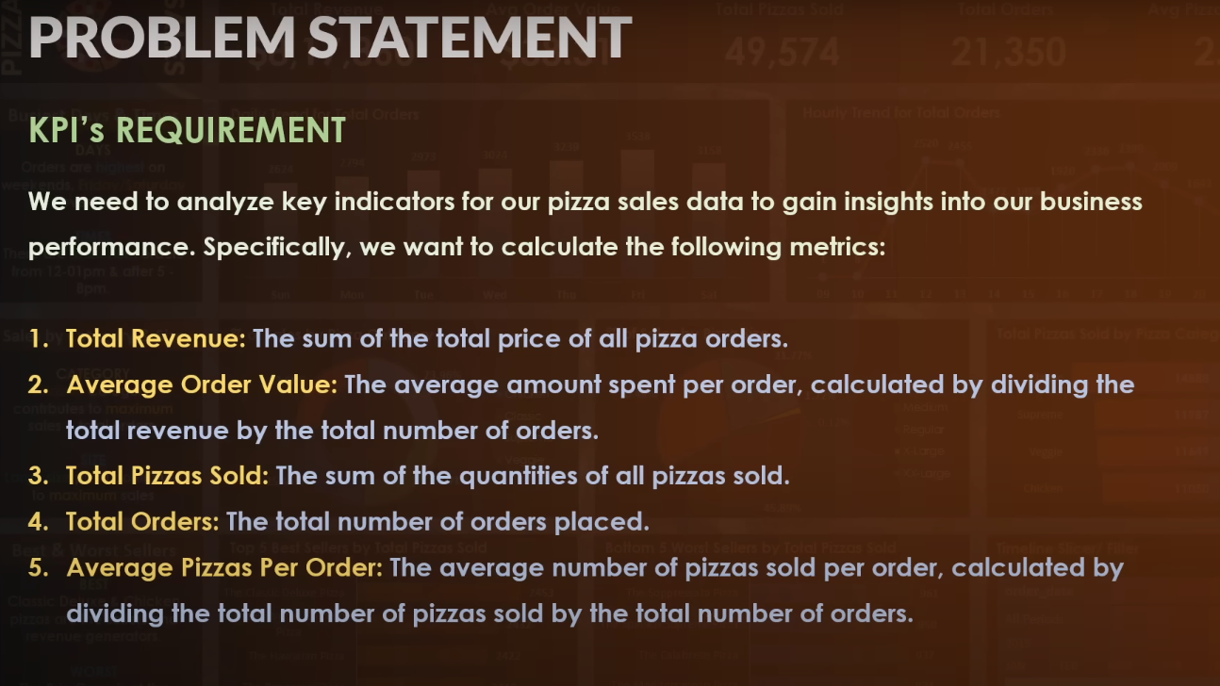
KPI’S REQUIREMENT

Slide 2
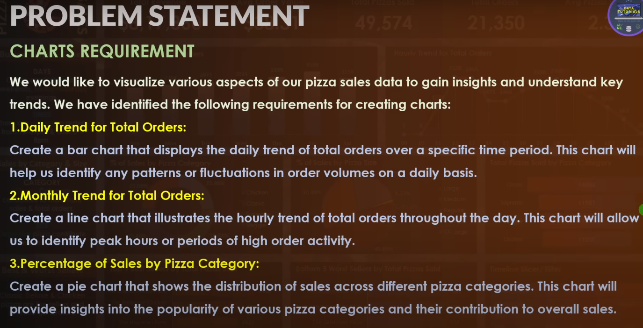
CHARTS REQUIREMENT

Slide 3
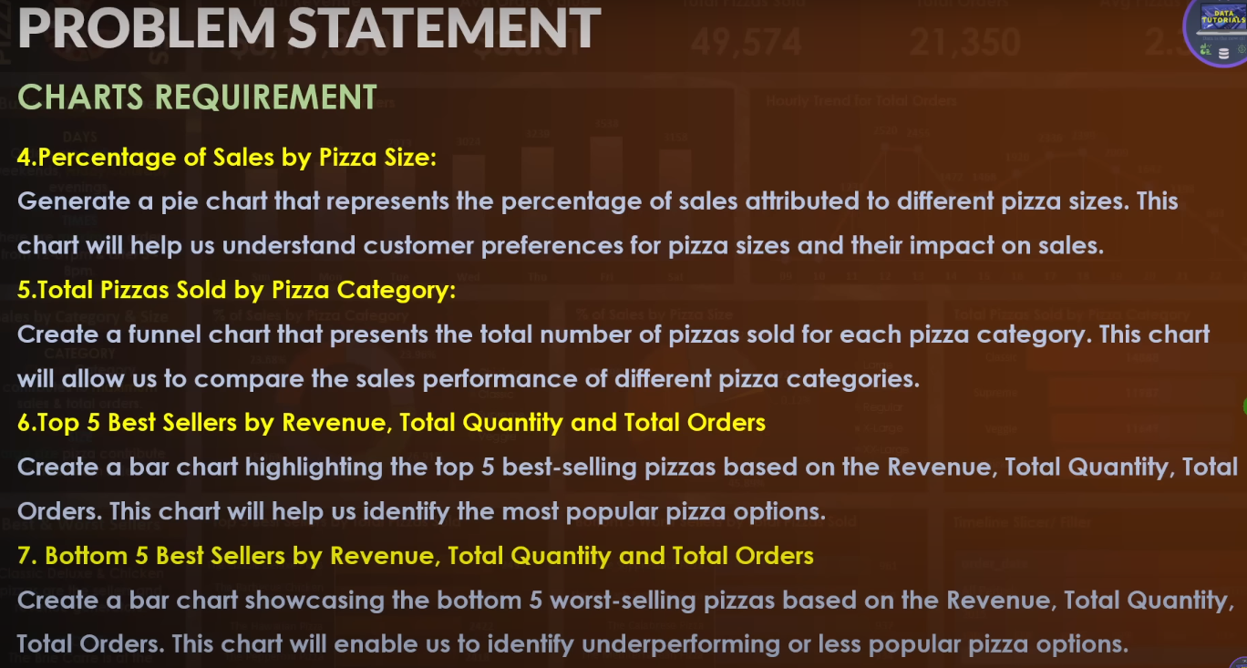
CHARTS REQUIREMENT

